Slide 1
Using School Immunization Rates and Venue Location Data to Choose Medical Clinic Locations
Kaif Patel
February 2, 2020

Slide 2
Introduction/Business Problem
Understanding how to choose the ideal location for opening a medical clinic
Of interest to medical professionals and stakeholders
Interests due to public health concerns and investor’s return on investments
Important to look at current patient supply and demand for medical clinics

Slide 3
Data
Patient ‘demand’ data comes from the Toronto Open Data Portal: “Immunization Coverage for Students Data”
It has immunization rates for each individual school as well as geographic coordinates
Medical clinic ‘supply’ data comes from the Foursquare API
We will look at how many medical clinics are within 3 km of each school

Slide 4
Methodology
After the data was cleaned a value was established on the population of nonvaccinated students per clinic
This value was used as a basis to gauge the supply and demand of medical clinics around schools with low vaccination rates

Slide 5
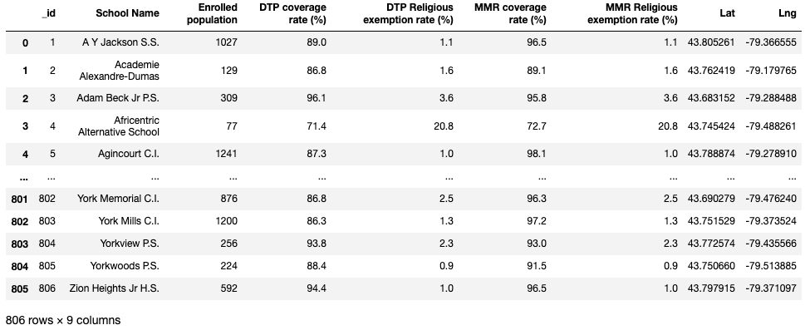
Dataframe before cleaning

Slide 6
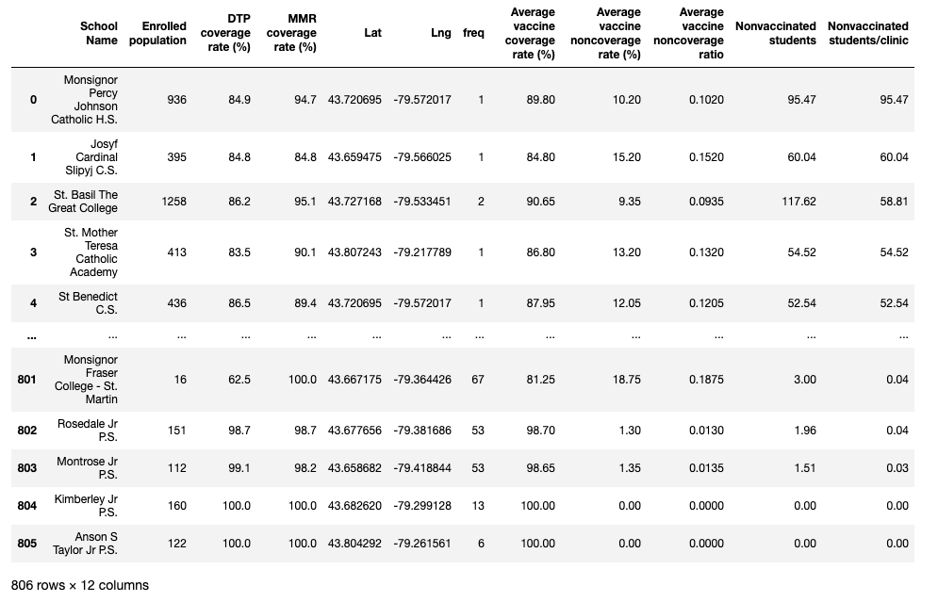
Dataframe after cleaning

Slide 7
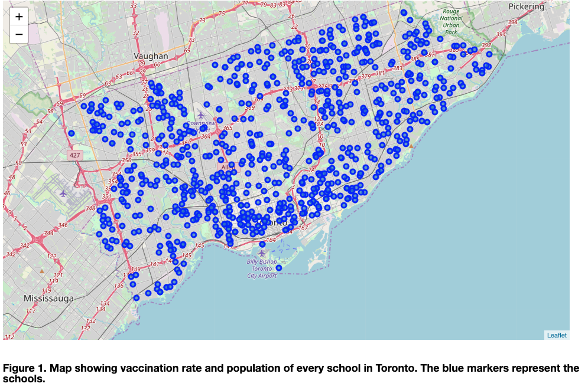
Map of schools

Slide 8
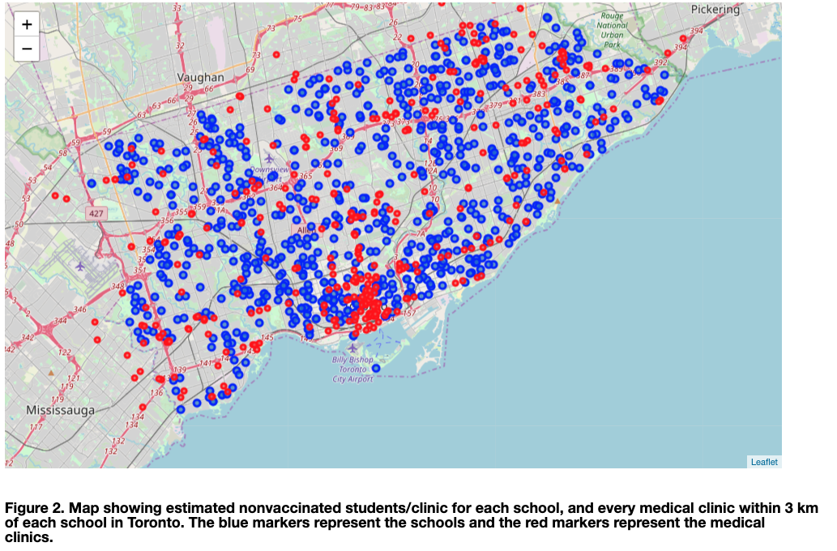
Map of schools and clinics

Slide 9
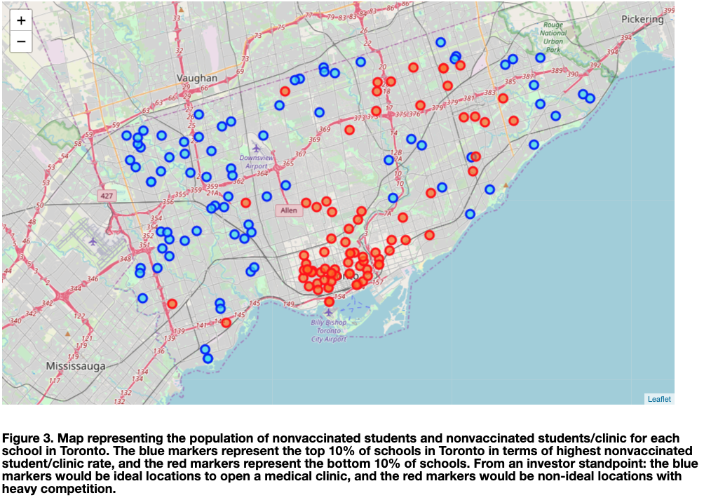
Map of top and bottom 10% of schools

Slide 10
Results
In terms of population of nonvaccinated students/clinic:
Top schools tend to be high population schools away from city center
Bottom schools tend to be low population schools closer to city center

Slide 11
Discussion
The top schools tend to be in the lower income areas of Toronto, mostly high schools
Many of these schools are in high immigrant areas, which doesn’t suggest immigrants are less likely to get vaccinated since the elementary schools in this area mostly have high vaccination rates, but it might be because the students are older and likely have more autonomy and may not be considering the vaccines as necessary
8/10 of the top schools are catholic schools which suggests these students may be more prone to opting out of vaccinations due to religious beliefs or maybe due to less stringent vaccination requirements

Slide 12
Discussion
The schools at the bottom of the dataframe tend to be low population schools, alternative and public elementary schools
These schools perhaps have more stringent vaccination requirements
These schools likely also have greater parental oversight, which may explain the really high vaccination rates

Slide 13
Conclusion
Investors looking to open a medical clinic should thus focus on areas outside the city center, with a lower income demographic
The west end of Toronto should be an ideal location to open a medical clinic
The data suggests that there is a possible correlation between vaccination rates and income

